Slide 1
Walking Trail

Slide 2
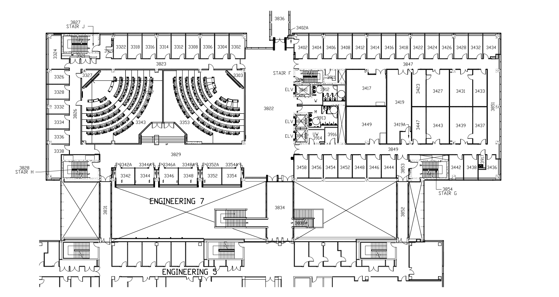
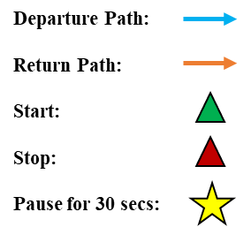

Slide 3
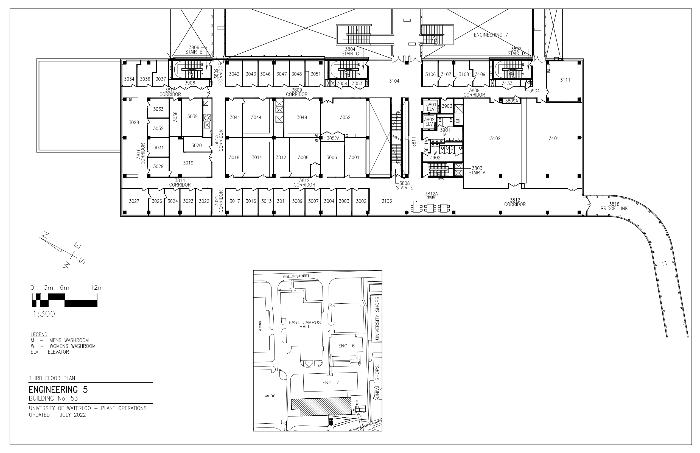

Slide 4
Stairs & Ramp Trail

Slide 6
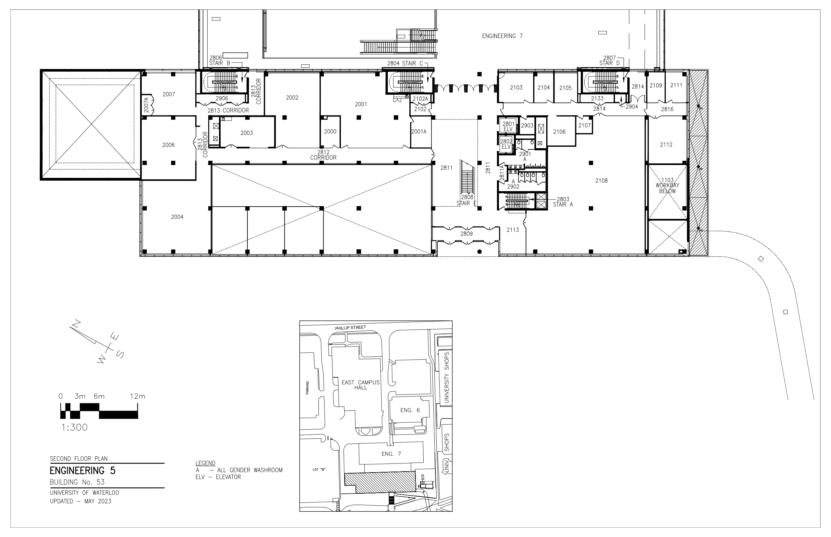

Slide 7
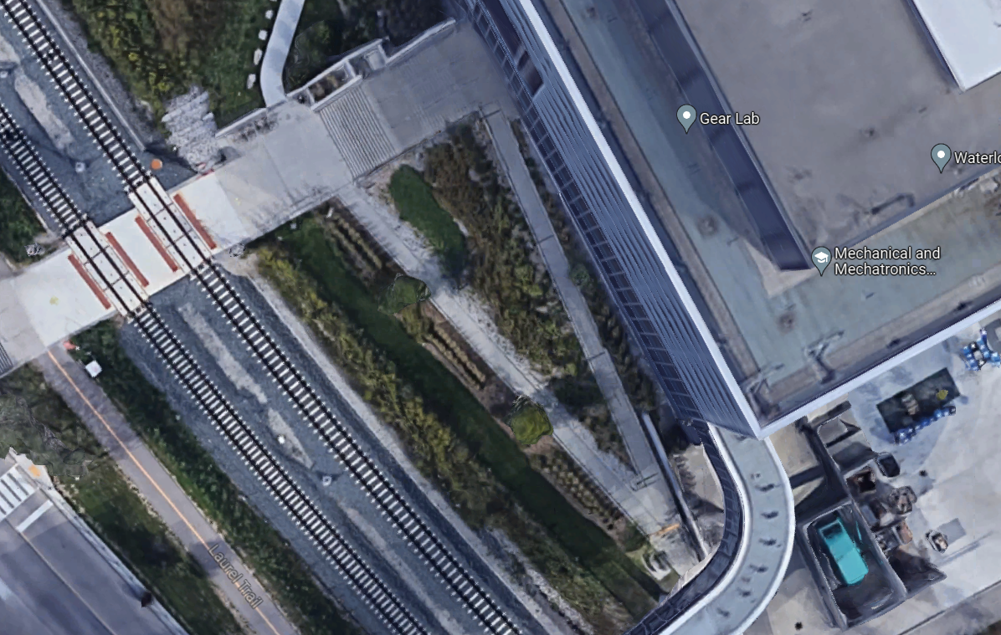

Slide 8
Departure Path:
Return Path:
Start:
Stop:
Pause for 30 secs:

